Slide 1
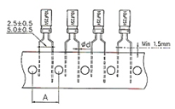
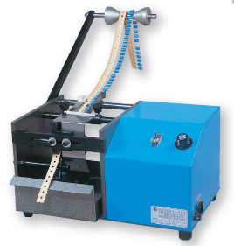
Loose Radial Lead Cutting Equipment
BEST SOLUTIONS TO MEET YOUR NEEDS
Automatic Taped Radial Lead Cutting Equipment
Loose Radial Lead Cutting Equipment
Loose Radial Lead Cutting Equipment
Loose Radial Lead Cutting Equipment
Automatic Taped Radial Lead Trimmer
ASI-TRLT-101
Taped Radial Lead Trimmer
Dimension:520L x380W x 300H mm
Power: 110V/220V AC 60/50Hz
Weight: 24kgs
Capability: 60,000 pieces/ Hour
Quiet, high performance motor with adjustable speed
Cut off taped radial Resistor, Capacitor, Crystal and similar components leads
Suitable for single bandoleer in roller/ reel or AMON box
Compact, suitable for short lead operation with precise dimension
Component counter is optional
ASI-TRLT-101 -Is for Standard paper tape bare hole pitch (A)-12.7mm
ASI-TRLTS-101-S -Is for Paper tape bare hole pitch (A)-15 mm
ASI-TRLS-101-S
Unlimited | Body dia.
3-20 mm | Lead Length | L
0.4-1.0mm | Wire | W
AIM Solder Israel ltd. Netser Sereni, 70395 ISRAEL
sales@asi-tech.co.il TEL: 972–8-9208844 FAX: 972-8-9207711

