Slide 1
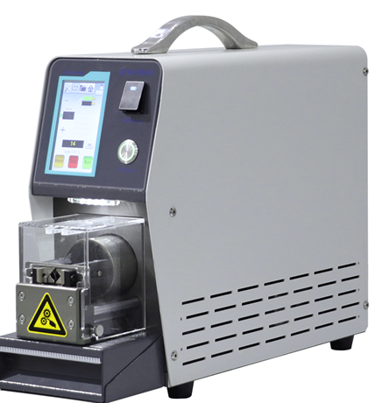
BEST SOLUTIONS TO MEET YOUR NEEDS
ASI-1180 - Servo Coaxial Stripping Machine
Technical data:
Model
Wire range
Stripping Length
Strip Length accuracy
Processing speed
Power
Air pressure
Dimension
Weight
ASI-1180
0.5 -8mm2
1-45mm
0.01mm
About 2s/pcs
220V 50/60Hz
0.5-0.7Mpa, 8m3*/h
525*155*310mm
About 30kg
AIM Solder Israel ltd. Netser Sereni, 70395 ISRAEL
sales@asi-tech.co.il TEL: 972–8-9208844 FAX: 972-8-9207711

